Slide 1
Efficient Probabilistic Logic Reasoning with Graph Neural Networks
Boyuan He
Haochen Li
Jingyue Shen

Slide 2
First-order logic
Formulas constructed using four types of symbols: constants, variables, functions, and predicates.
Constants: objects in the domain of interest e.g. Brian, Josh, Boyuan
Variables: e.g. people
Functions: a mapping from tuple of objects to objects. E.g. FriendsOf
Predicates: relations among objects (Friends) or attributes of objects (Smokes)

Slide 3





Knowledge Graph
Knowledge Graph is a tuple
-- set of entities/constants
-- set of relations/predicates
-- set of observed facts

Slide 4







Knowledge Graph
Predicate is a logic function
-- have relation with (asymmetric)
Ground predicate is predicate with a set of entities assigned
-- assignment ( → )
each ground predicate ≡ a binary random variable
Observed fact is truth value {0, 1} assigned to a ground predicate

Slide 5
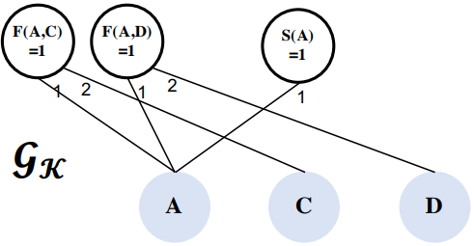

Knowledge Graph
knowledge base represented by a bipartite graph
-- constant
-- observed facts (factor)
-- a set of edge
edge exists, if the ground predicate associated with o uses c as an argument in its i-th argument position

Slide 6

Markov Logic Networks
MLNs use logic formulae to define potential functions in undirected graphical models
logic formulae -- binary
Example
-- assignment (similar to KG)
-- entire collection of consistent assignments
ground formula -- formula with constants assigned to all of its arguments

Slide 7
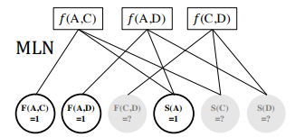
Markov Logic Networks
MLNs use logic formulae to define potential functions in undirected graphical models
logic formulae -- binary
Example

Slide 8

Markov Logic Networks
MLN can be represented as:
-- observed facts, -- unobserved facts
-- partition function summing over all ground predicates
-- assignment (similar to KG)
-- entire collection of consistent assignments
-- potential function in previous slide

Slide 9
KG vs MLN
Knowledge graphs | MLN
Sparse Number of edges linear to the number of entities | Denser number of edges high-order polynomials to the number of entities number of nodes can be quadratic or more tothe number of entities

Slide 10



Variational EM framework for MLN
Instead of optimizing the log-likelihood of all the observed facts
Optimize the variational evidence lower bound (ELBO) of the data log-likelihood using variational EM algorithm
-- variational posterior distribution of the latent variables
-- true posterior

Slide 11
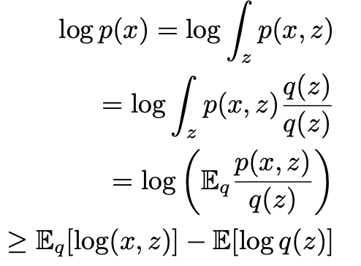
Variational EM framework for MLN
Derivation of lower bound:
f(E[X]) >= E[f(X)] (Jensens)

Slide 12



Variational EM algorithm E step
Minimize the KL divergence between and
Exact inference of MLN is intractable and NP-complete
So use mean-field variational distribution to approximate, each unobserved ground predicate inferred as follows:
-- factorized distribution (follow bernoulli distribution)
is parameterized using ExpressGNN

Slide 13

Variational EM algorithm E step
After parameterization can be rewritten as:

Slide 14



Variational EM algorithm E step
Both and involves a large number of terms which can make it very computationally expensive
So the author uses mini-batches of ground formulae
In each optimization iteration
Sample a batch of ground formulae
For each formulae sampled, compute
By by taking the expectation of the corresponding potential function with respect to the posterior of the involved latent variables

Slide 15
Variational EM algorithm E step
If the task have sufficient label data, add supervised learning objective
And the overall objective function is

Slide 16




Variational EM algorithm M step
learn the weights of logic formulae in MLN with fixed
is no longer a constant, and has exponential number of terms, so is intractable to directly optimize the ELBO
Use pseudo-log-likelihood:
-- Makarov blanket of

Slide 17



Variational EM algorithm M step
For each formula that connects to its Markov blanket, optimize weight
Use gradient descent, with the derivative:
= 0 or 1, if is observed fact
= , otherwise

Slide 18
Variational EM algorithm M step
Computationally intractable to use all ground predicates to compute the gradients
So consider all the ground formulae with at most one latent predicate and pick up the ground predicate if its truth value determines the formula’s truth value
Only need to keep a small subset of ground predicates that can directly determine the true value of a ground formula

Slide 19
ExpressGNN
Need to have a expressive and efficient network to approximate true posterior distribution in step E
ExpressGNN involve three parts:
Vanilla graph neural network (GNN)
tunable embeddings
uses the embeddings to define the variational posterior

Slide 20
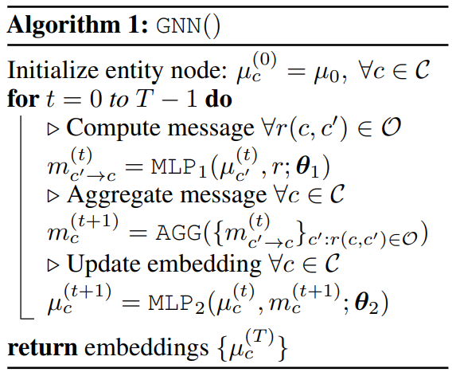



ExpressGNN
Build a GNN on the knowledge graph much smaller than MLN
and are shared across the entire graph and independent of the number of entities
GNN is a compact model with parameters given d dimensional embeddings

Slide 21



ExpressGNN
For each entity in the KG, augment its GNN embedding with a tunable embedding ---- as
The tunable embeddings increase the expressiveness of the model
Number of parameters in tunable embeddings is

Slide 22



ExpressGNN
variational posterior defined as:
number of parameters in is

Slide 23

ExpressGNN
compact GNN assigns similar embeddings to similar entities in the KG
expressive tunable embeddings allows encoding of entity specific information beyond graph structures
overall number of trainable parameters is , and by controlling d and k, we can control the trade-off between compactness and expressiveness

Slide 24
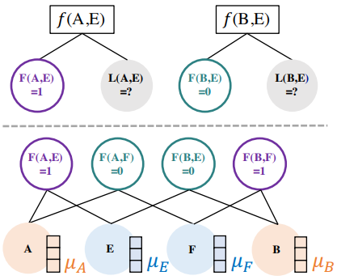



theoretical analysis on ExpressGNN
vanilla GNN produces the same embedding for some nodes that should be distinguished, for example
A and B have opposite relations with E, but GNN will produce same embedding
And have different posteriors, but they get same
ExpressGNN avoid this problem by allowing additional tunable embeddings

Slide 25
ExpressGNN
Efficient: works on the knowledge graph, instead of the huge MLN grounding graph, more efficient than the existing MLN inference methods
Compact: the GNN model with shared parameters can be very memory efficient
Expressive: the GNN model can capture structure knowledge in the knowledge graph, and the tunable embeddings can encode entity-specific information
Generalizable: with the GNN embeddings, ExpressGNN may generalize to new entities or even different but related knowledge graphs

Slide 26
Experimental Setup
Benchmark datasets
UW-CSE , Cora, synthetic Kinship datasets, and FB15K-237
General settings
Linux machine with RTX 2080 Ti, Intel Xeon Silver 4116 and 256GB RAM
Hyperparameters:
use 0.0005 as the initial learning rate, and decay it by half for every 10 epochs without improvement
two-layer MLP with ReLU activation function for each embedding update step
MLP parameters is different for steps, edge types and direction of embedding aggregation
...

Slide 27
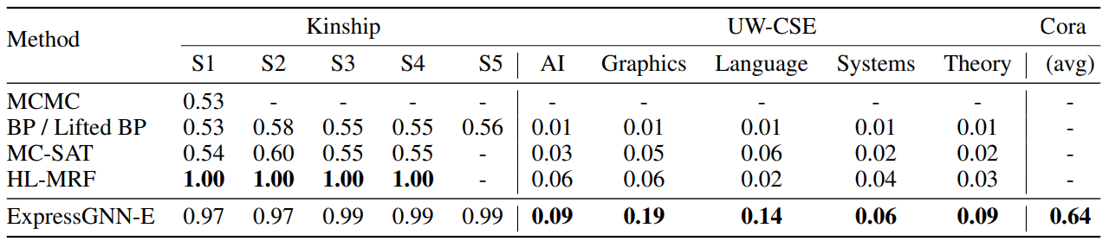
Experiment Result

Slide 28
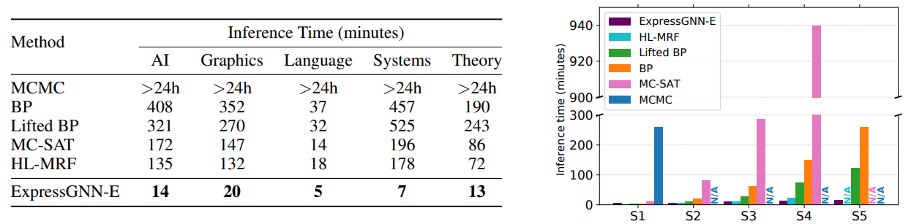
Experiment Result

Slide 29
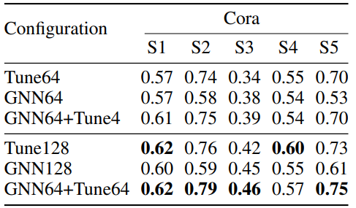
Experiment Result

Slide 30
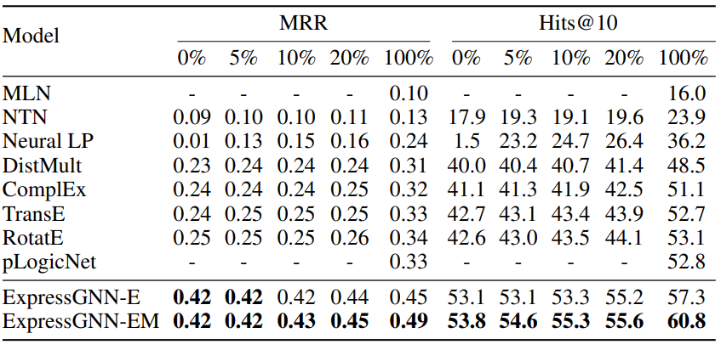
Experiment Result

